Slide 1
HTML code editor

Slide 2
Introduction
An HTML editor is a program for editing HTML, the markup of a web page.
Although the HTML markup in a web page can be controlled with any text editor, specialized HTML editors can offer convenience and added functionality.
A source-code editor is a text editor program designed specifically for editing source code of computer programs.
Source-code editors are a fundamental programming tool, as the fundamental job of programmers is to write and edit source code.

Slide 3
Requirements
SR.NO | Name | Specification | Quantity
1 | Computer system | Ram: minimum 2GB, Processor:(i3-i5)preferable | 1
2 | Web browser | Chrome/ M-Edge | 1
3 | Code editor | Preferable notepad++ or vs code | 1

Slide 4
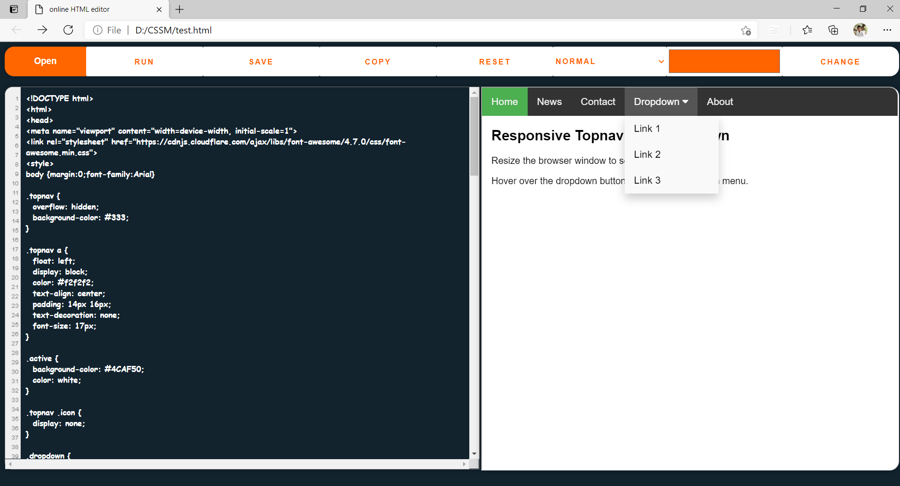
Output

Slide 5
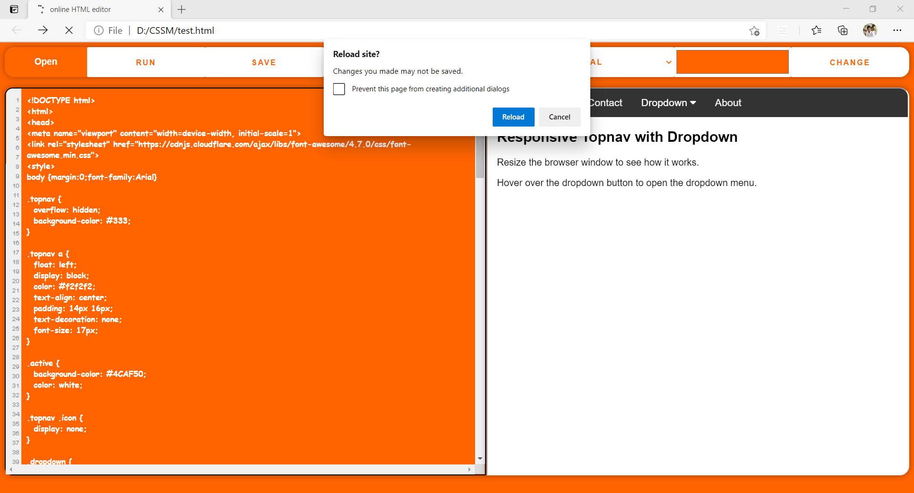
Prompt

Slide 6

Font changing

Slide 7
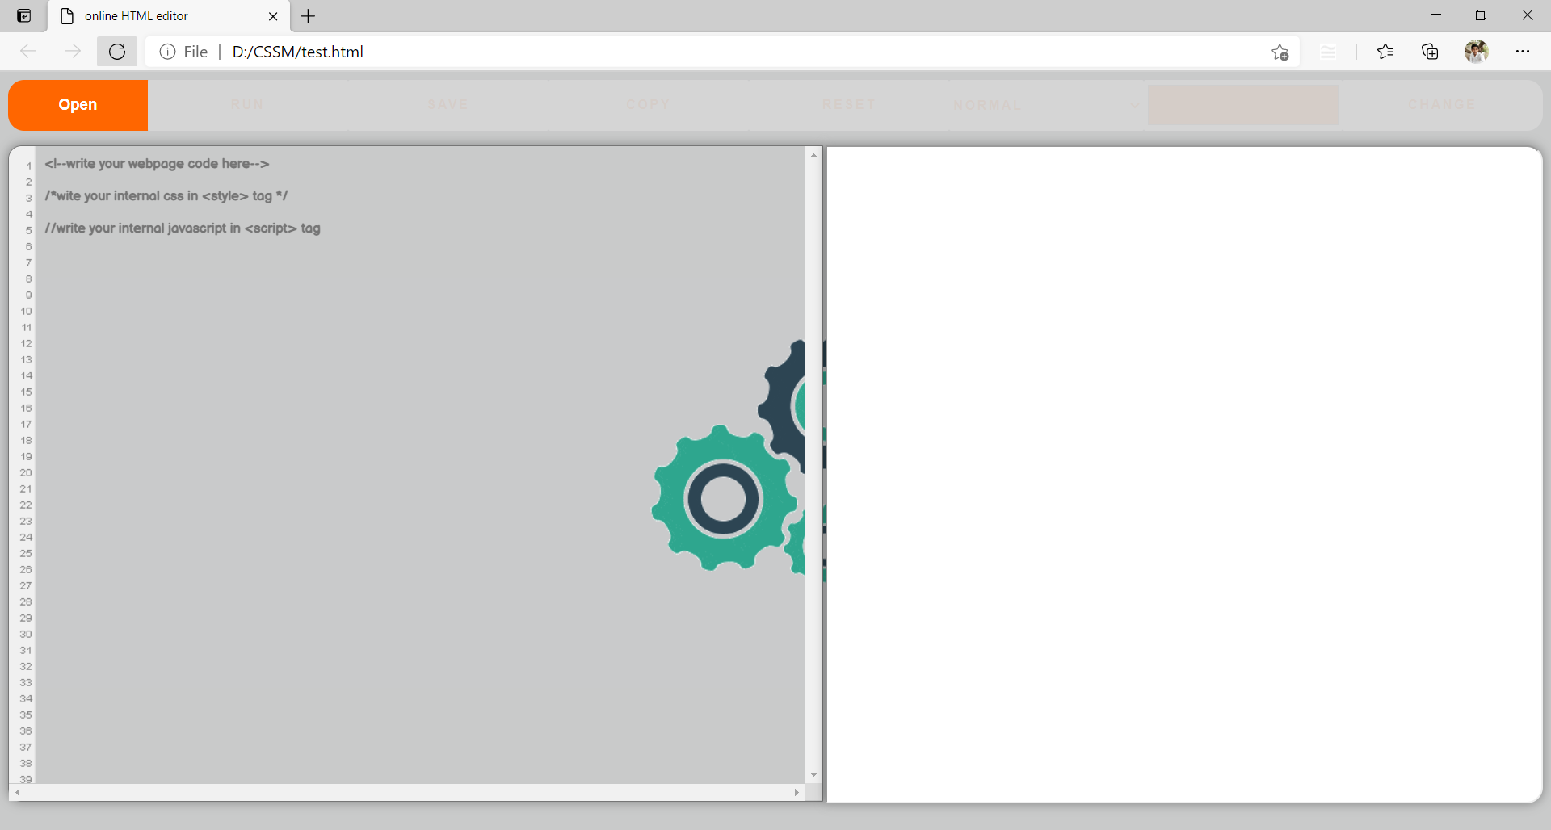
Loading Animation

Slide 8
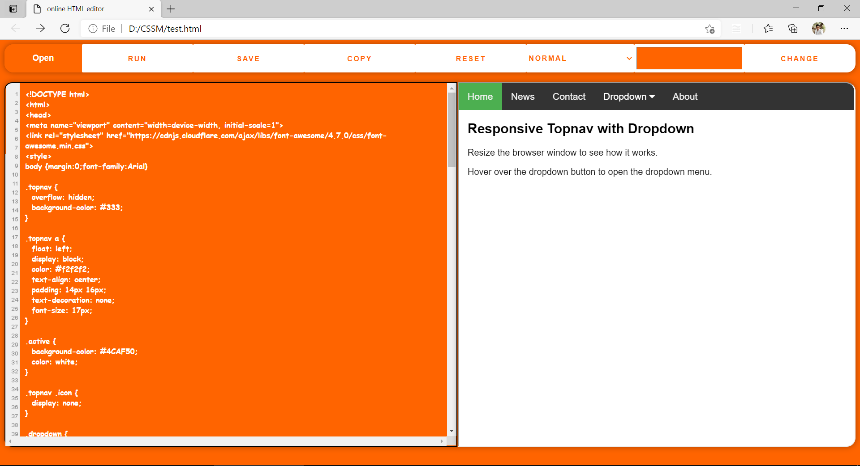
Background color changing

Slide 9
Future scope
a) To make it more responsive so it can be used on most of the devices.
b) To build a whole server to store and manage data of users.
c) To make its GUI more efficient, so users will able to use it easily.
d) To use a syntax highlighter, to reduce codes syntax errors.

Slide 10
conclusion
This application has developed under the philosophy of the open source software. Strong efforts were made so that JavaScript to be the only language that has been used.
Even though there are some differences between browsers the philosophy remains the same.
Concluding, JavaScript and its combination with the HTML 4.0 and the C.S.S. offer a lot of potential to the developer.
Considering the fact that quit a few similar applications exists over the internet, there are significant advantages for someone to use JavaScript instead of another script language.

Slide 11
Reference
(PDF) Web Based html-rich text Editor “web-editor” Using Open Source Software (researchgate.net)
W3Schools Online Code Editor
GeeksforGeeks | A computer science portal for geeks
Stack Overflow - Where Developers Learn, Share, & Build Careers

